Slide 1
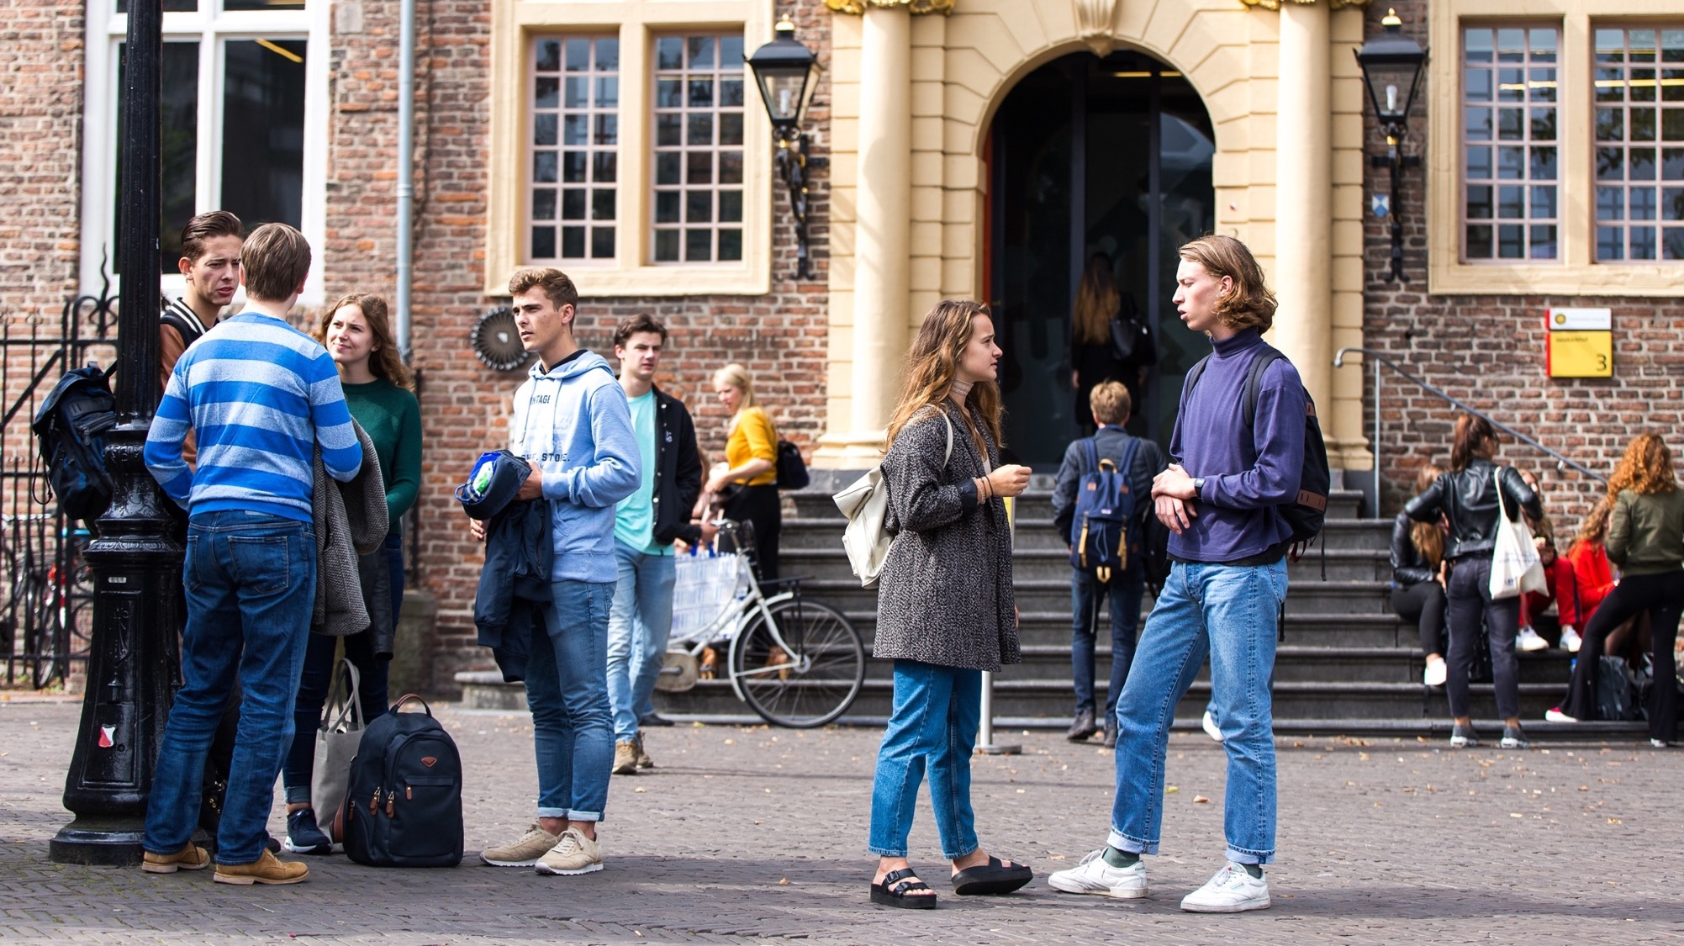


Slide 2
Research Engineering @Utrecht University
Shiva Nadi
Dawa Ometto
Research Software Engineer

Slide 3

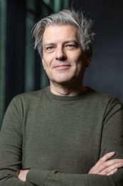
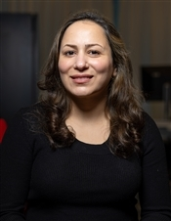
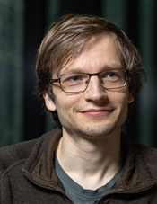
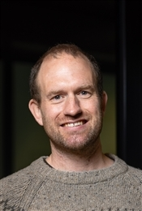
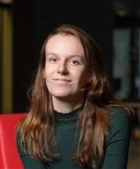
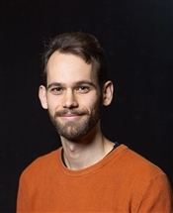
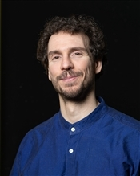
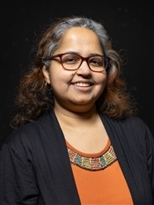
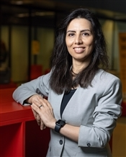
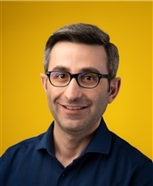
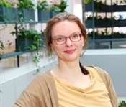

Who we are
Maarten Schermer
Shiva Nadi
Raoul Schram
Jelle Treep
Matty Vermet
Roel Brouwer
Dawa Ometto
Modhurita Mitra
Parisa Zahedi
Ünal Aksu
Christine Staiger
uu.nl/research-engineering

Slide 4
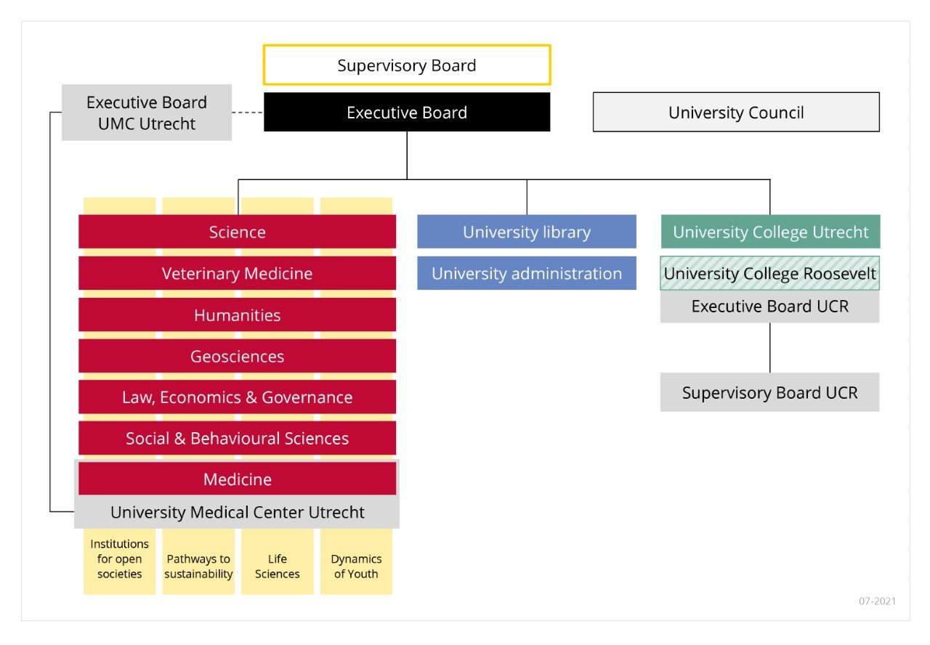

UU organisation
ITS
Research Engineers
RDM support
Data stewards, liaisons, subject specialists
RDS
Data Consultants
Image: https://www.uu.nl/en/organisation/governance-and-organisation

Slide 5

Typical questions
I am writing a research proposal and need some help with assessing technical feasibility.
Could you think along with me?
Can you help me to train a model to analyse my data?
I developed R code during my PhD research.
How can I share this with my
colleagues?
Large Dataset
Software Management Plan
Data Collection
GPU
Parallel Programming
Data Management Plan
Computationaly Intesive Tasks
Memory
Packaging your code
FAIR
Best Practices
Train a Model
https://utrechtuniversity.github.io/research-engineering/

Slide 6
Typical questions
Large Dataset
Data Collection
Software Management Plan
Data Management Plan
GPU
Computationaly Intesive Tasks
Memory
Packaging your code
FAIR
Best Practices
Train a Model
https://utrechtuniversity.github.io/research-engineering/

Slide 7




How can we support your research?
Projects
HPC
Consultancy
Consultancy
Training
https://utrechtuniversity.github.io/research-engineering/

Slide 8



Projects
developing sustainable and robust research software
Contact us:
Send an email to research.engineering@uu.nl
Fill in the form: forms.uu.nl/universiteitutrecht/re_request
https://utrechtuniversity.github.io/research-engineering/

Slide 9
Projects
For whom?
For all researchers at Utrecht University
How does it work?
Accepting projects from researchers all year around (send us an email!)
0.25 fte total workload
Yearly thematic call with a deadline
Last year: Improve and automate your workflow/Data Visualisation
0.5 fte total workload
Projects financed by the researcher
Workload depends on financing
What kind of projects?
Machine learning
Improving the quality of R/Python code
Packaging R/Python code for better reusability
And more!
uu.nl/research-engineering

Slide 10
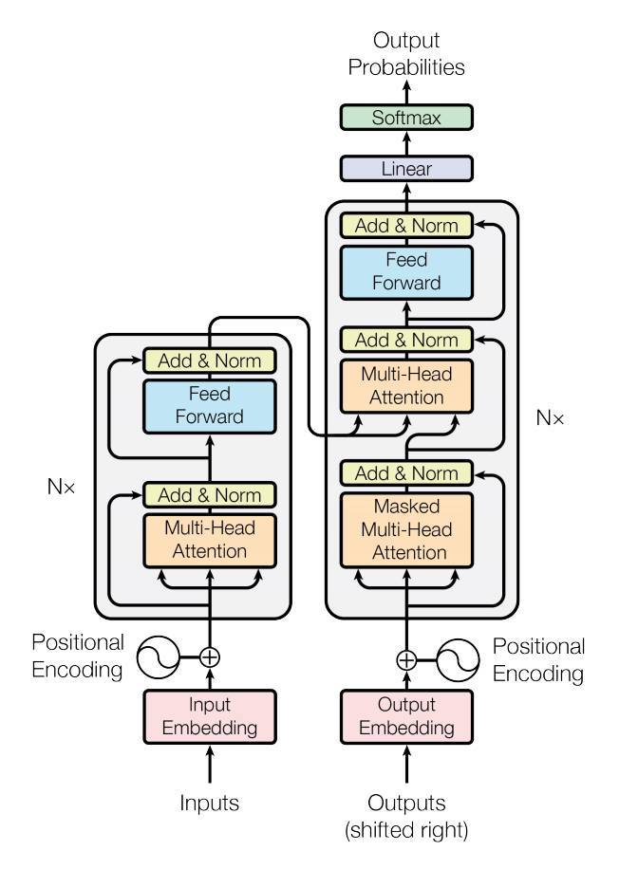
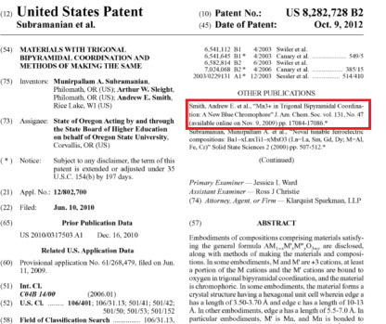
Breakthrough Innovations
Goal:
Develop software for large scale comparison of patent texts
Faculty:
Benjamin Cornejo Costas
(Economic Geography)
Expertise:
Machine learning,
Big data
https://utrechtuniversity.github.io/research-engineering/

Slide 11
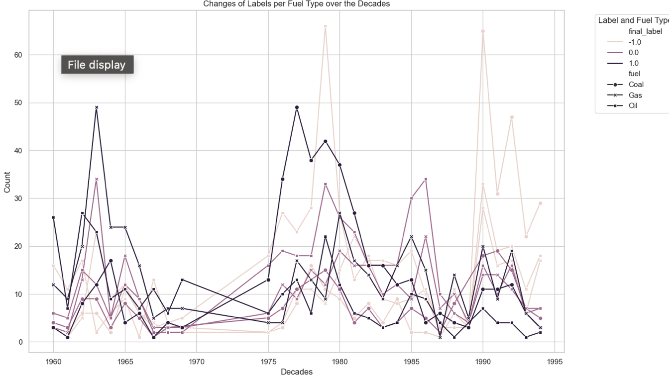
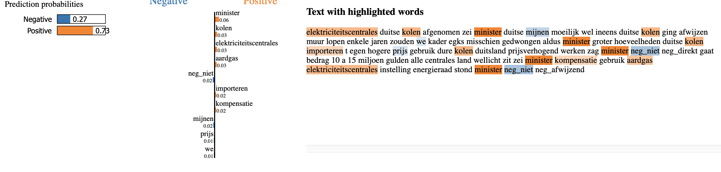
Historical news sentiment analysis
Goal:
Develop software to analyze and track sentiment changes in historical news articles from the 18th and 19th centuries regarding fusiliers and fuels..
Faculty:
Pim huijnen
(Humanities)
Expertise:
Machine learning,
Efficient computing, Big data
https://utrechtuniversity.github.io/research-engineering/

Slide 12
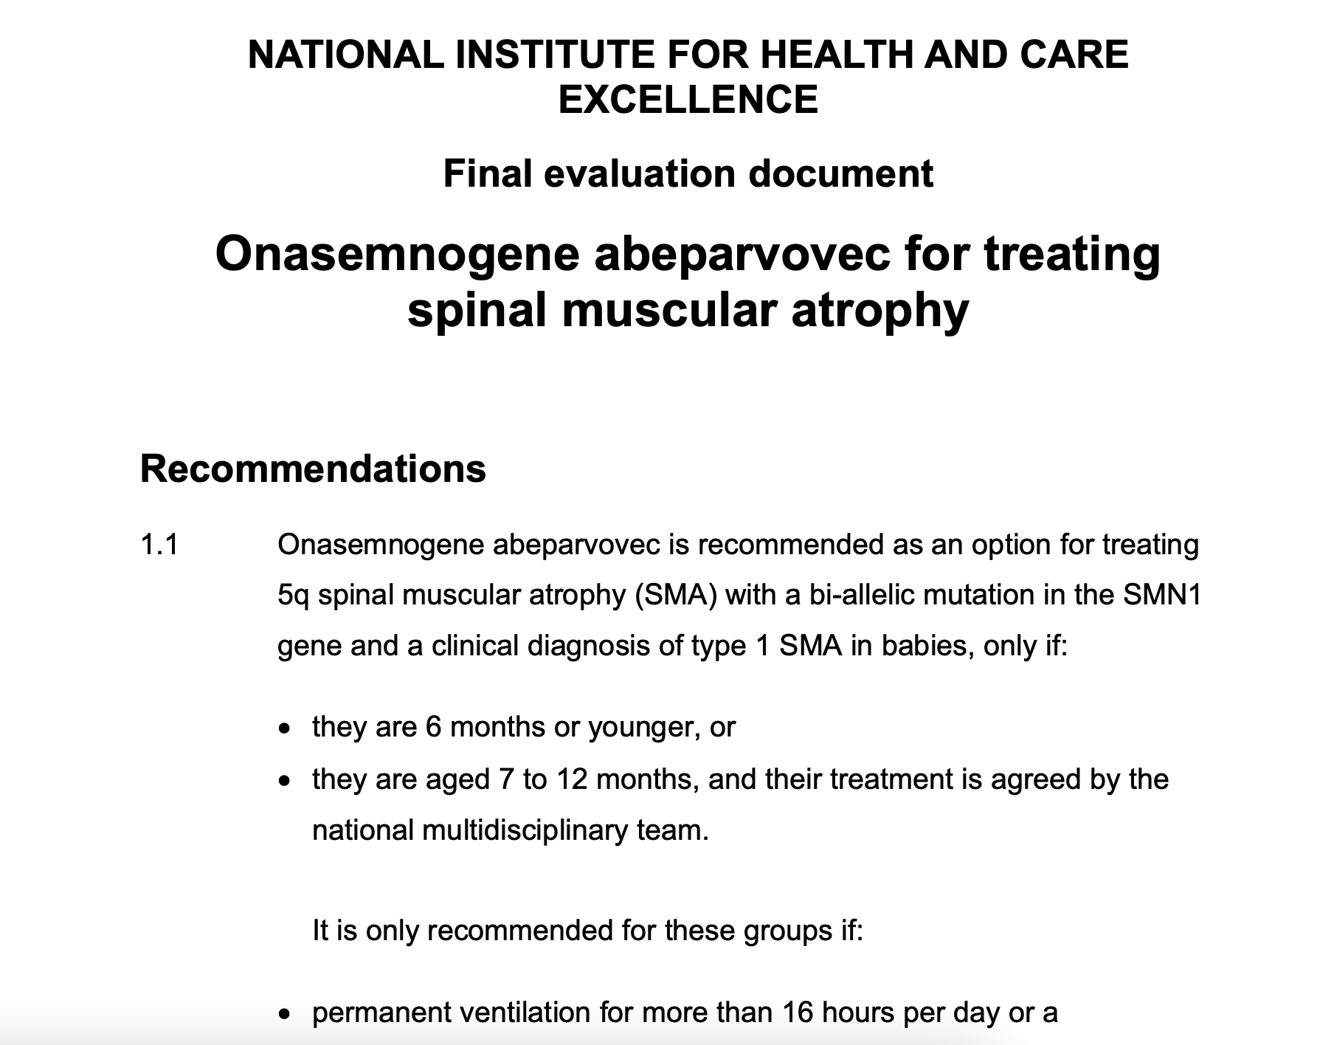
Health Technology Assessment
Goal:
Develop software to data extraction from HTA documents
Faculty:
Jan-Willem Versteeg
(Pharmaceutical sciences)
Expertise:
Machine learning,
Efficient computing
https://utrechtuniversity.github.io/research-engineering/

Slide 13

Training with our colleagues from the library
For whom?
For all researchers at Utrecht University + UMCU
How does it work?
https://www.uu.nl/en/research/research-data-management/workshops
One day or two half-day workshops
Entry-level
No costs
Which courses?
Introduction to R
Introduction to Python
Writing reproducible software
Quick start to Data Management
Data Management plans
uu.nl/research-engineering

Slide 14

RDM Support- Walk-in events
Struggling with your research data or software?
Wondering what to do with the large amount of data you have collected?
Looking for a suitable digital technology to apply in your research project?
curious about making your data and software open and FAIR?
Walk-in hours every Monday 3pm-5pm at the library
https://www.uu.nl/en/research/research-data-management/workshops
uu.nl/research-engineering

Slide 15
RDM Support – Programming cafés
Meet other researchers
Ask questions related to programming
Improve your programming skills
Programming café: SeptFirst Thursday of the month, 3-5 PM
info.rdm@uu.nl
https://www.uu.nl/en/research/research-data-management/workshops
uu.nl/research-engineering

Slide 16

Consultancy
For whom?
For all researchers at Utrecht University
How does it work?
Contact us:
Send an email to research.engineering@uu.nl
Fill in the form: forms.uu.nl/universiteitutrecht/re_request
Book a meeting for HPC
We set up a meeting (or a few if necessary) to discuss your question.
What kind of questions?
Problems with Git
My code is not working (properly)!
I want to start using the HPC facilities and need credits
Exploring software solutions for new research questions
uu.nl/research-engineering

Slide 17

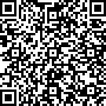

High Performance Computing
Compute clusters
Virtual Research Environment
Cloud Computing
My data is
too big
My laptop is
too slow
Consultancy
Credits
Engineering
https://utrechtuniversity.github.io/research-engineering/

Slide 18
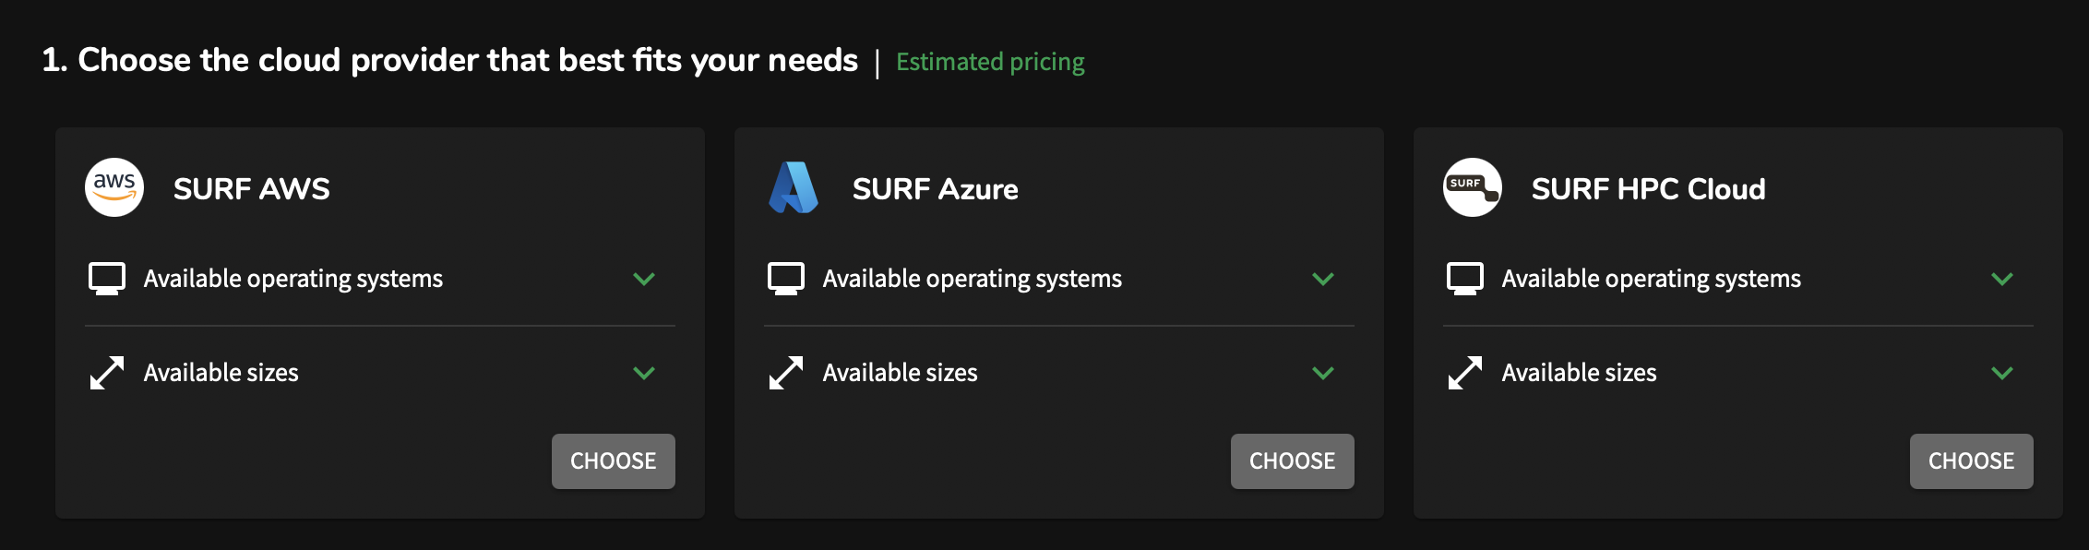
HPC services
UU Platforms
High performance cluster nodes in the facalty level
National SURF facilities
Research cloud
Snellius
Commercial providers
Amazon Web Services
Microsoft Azure
https://utrechtuniversity.github.io/research-engineering/

Slide 19
HPC services
For whom?
All researchers and students at Utrecht University.
credits
Up to 10,000 free credits for the national HPC and Cloud systems at SURFsara (Snellius and Research Cloud)
Meant for project start-ups, testing purposes and small research projects
What do we offer?
Consultancy and support on choosing a suitable computing platform
Getting access to computing platforms
Consultancy and support when applying for funding
Giving support when getting started with computing platforms
Adapting your code and data for use on computing platforms
https://utrechtuniversity.github.io/research-engineering/

Slide 20

HPC Training and Workshops
Bi-weekly workshops organized by UU
Getting started with Virtual Research Environments (VREs)
High Performance Computing Spring School
from 12 to 22 May 2025
Organized by UU and SURF
Courses organized by SURF
Introduction to Supercomputing, part I
Introduction to Supercomputing, part II
Introduction to Supercomputing, part III
https://utrechtuniversity.github.io/research-engineering/

Slide 21
HPC services
A Virtual Research Environment (VRE) is a temporary compute environment that enables researchers to work interactively and remotely on research. Utrecht University provides VREs based on SURF Research Cloud, which is a good alternative for commercial cloud providers like Amazon Web Services and Microsoft Azure.
https://utrechtuniversity.github.io/research-engineering/

Slide 22


Contact us
research.engineering@uu.nl
uu.nl/research-engineering/
uu.nl/research-engineering

